Slide 1
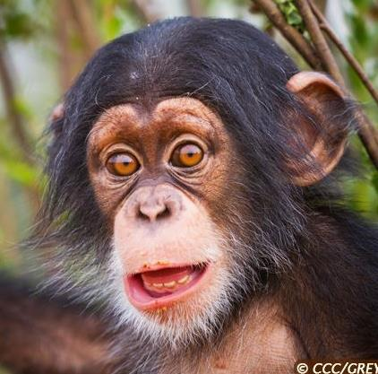
What’s good or bad for chimpanzees ?
Help me spot what will help me survive and thrive in the wild and what will put me in danger
GOOD
OR
BAD
START

Slide 2
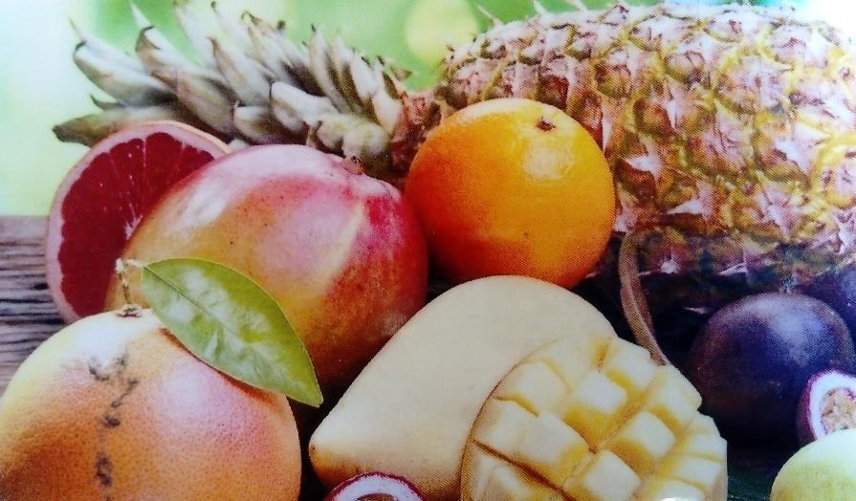
GOOD
OR
BAD

Slide 3
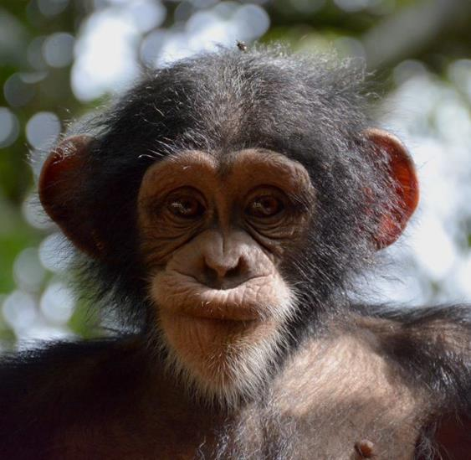
Wrong answer, start again !!

Slide 4
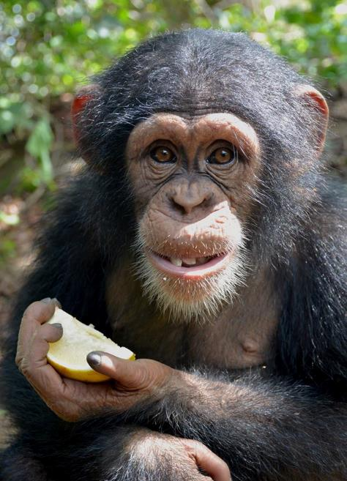
Right answer !!

Slide 5
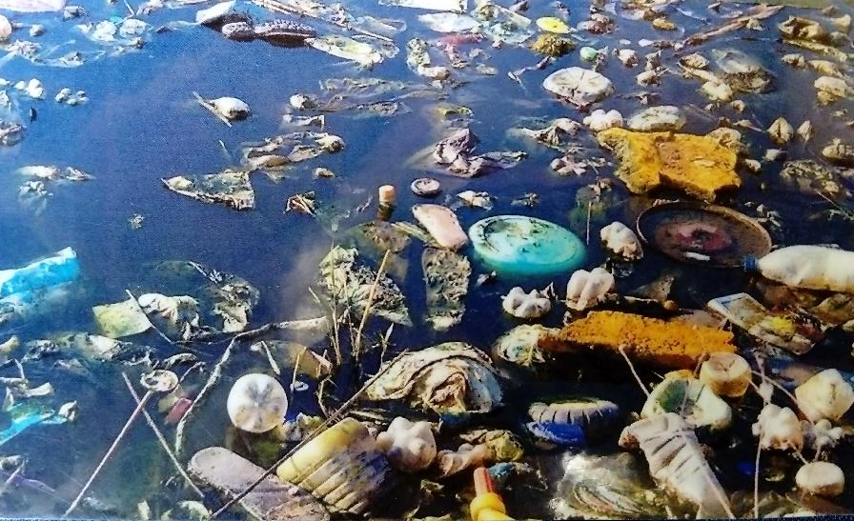
GOOD
OR
BAD

Slide 6
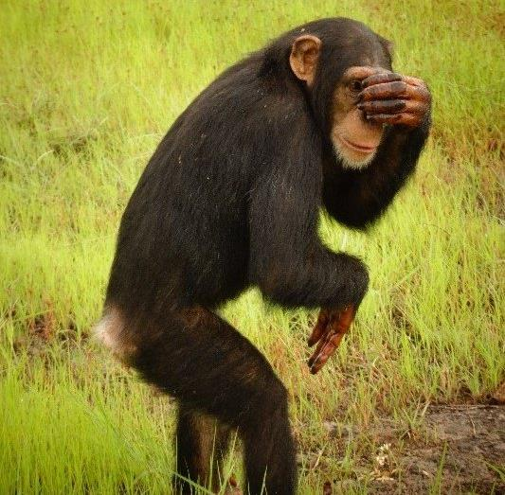
Wrong answer, start again !!

Slide 7
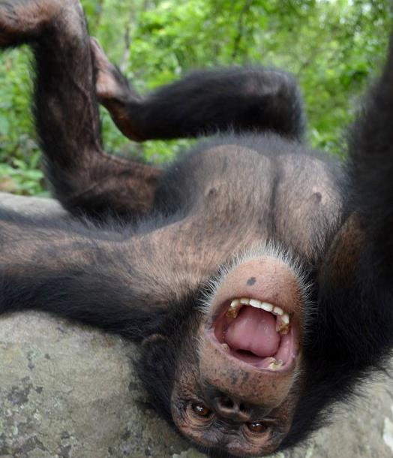
Right answer !!

Slide 8
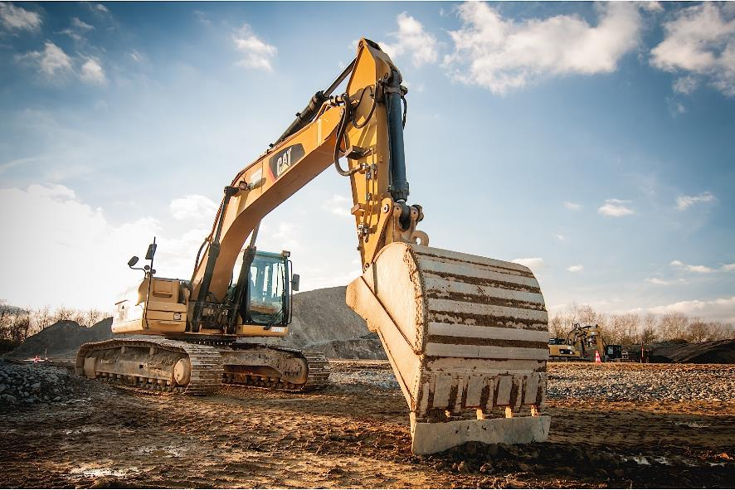
GOOD
OR
BAD

Slide 9
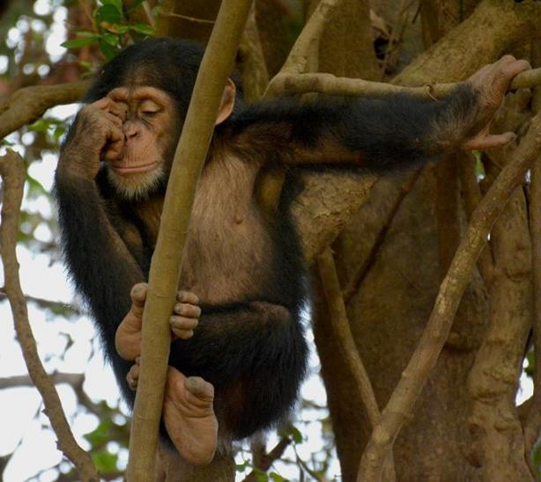
Wrong answer, start again !!

Slide 10
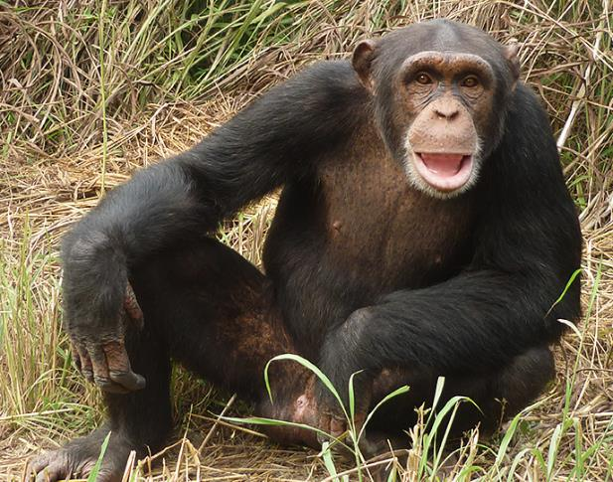
Right answer !!

Slide 11
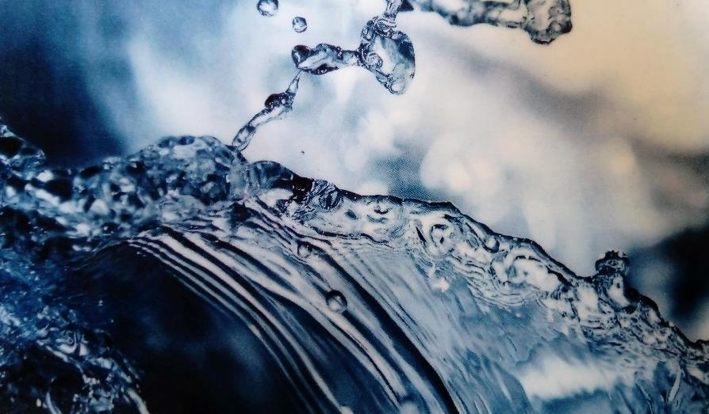
GOOD
OR
BAD

Slide 12
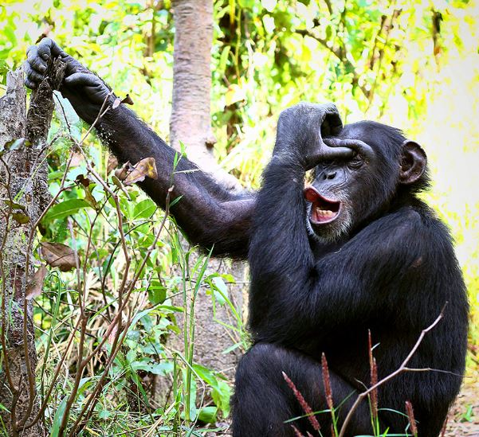
Wrong answer, start again !!

Slide 13
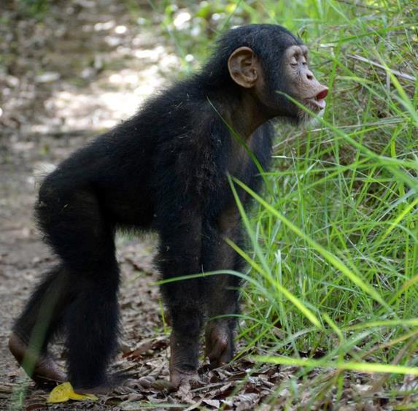
Right answer !!

Slide 14
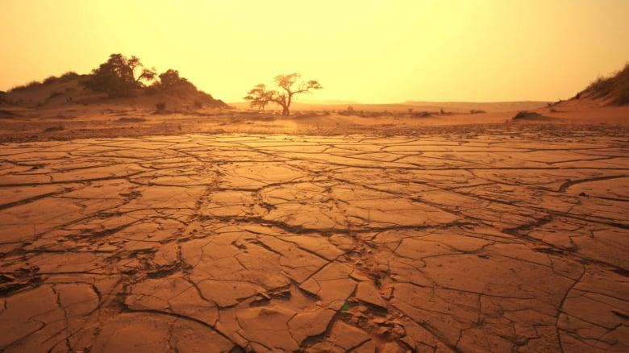
GOOD
OR
BAD

Slide 15
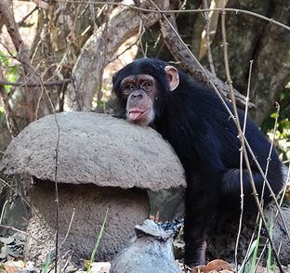
Wrong answer, start again !!

Slide 16
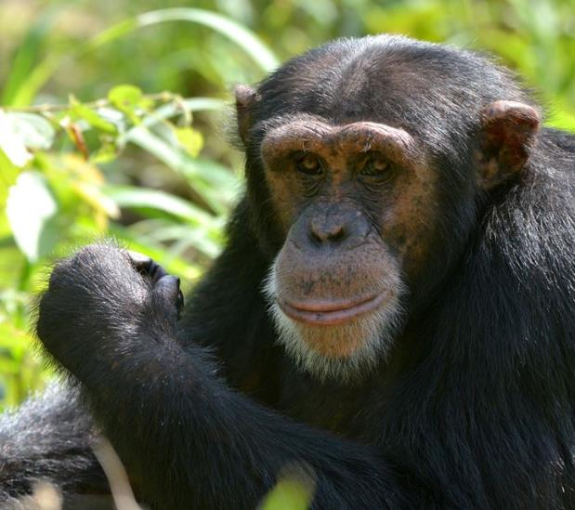
Right answer !!

Slide 17
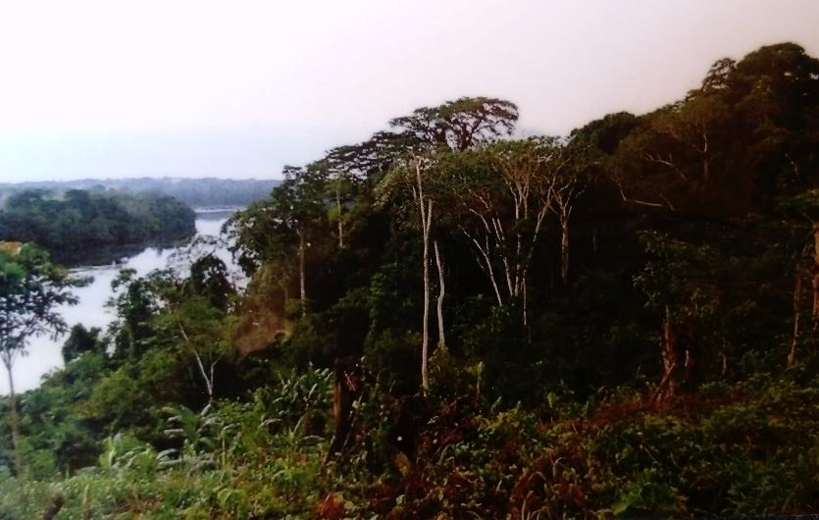
GOOD
OR
BAD

Slide 18
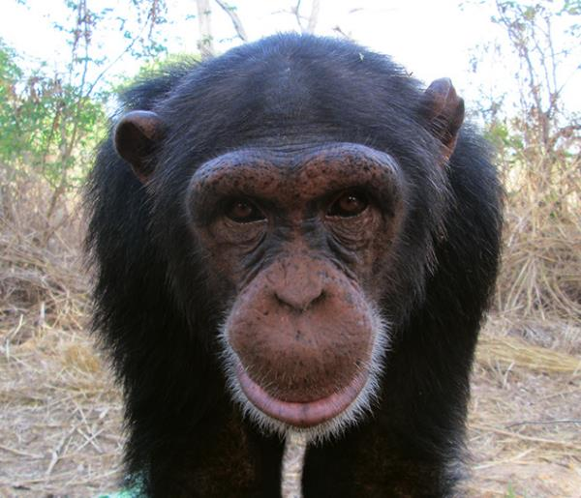
Wrong answer, start again !!

Slide 19
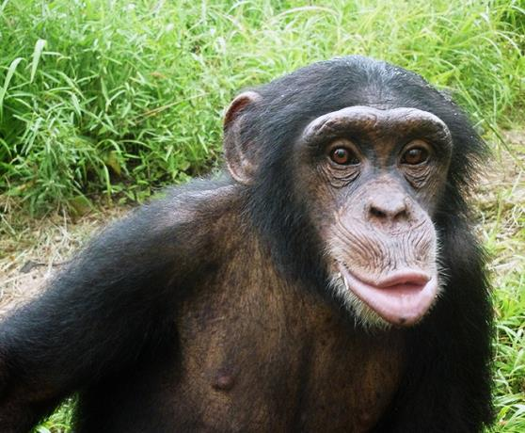
Right answer !!

Slide 20
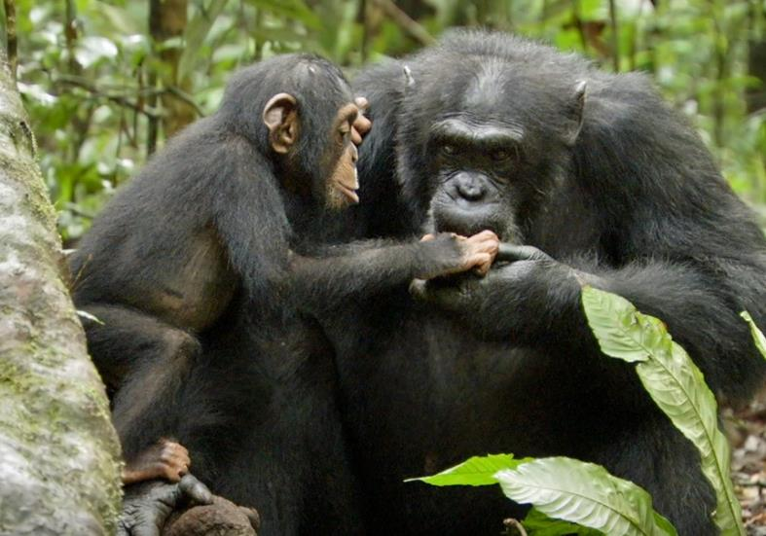
GOOD
OR
BAD

Slide 21
Wrong answer, start again !!

Slide 22
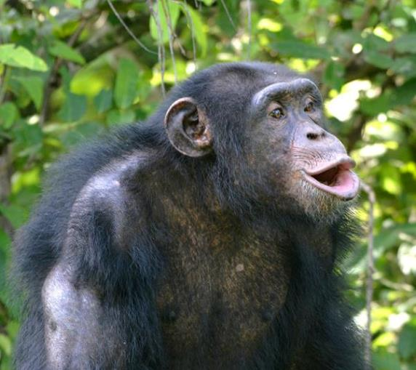
Right answer !!

Slide 23
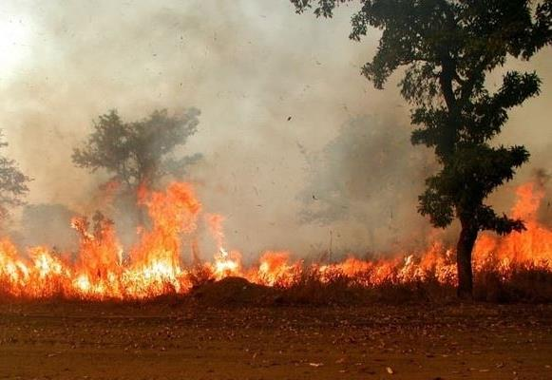
GOOD
OR
BAD

Slide 24
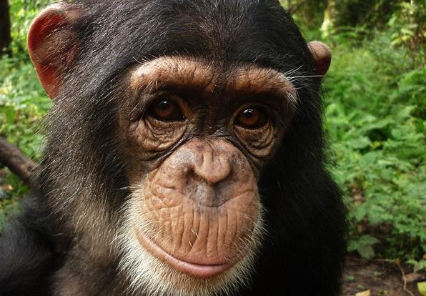
Wrong answer, start again !!

Slide 25
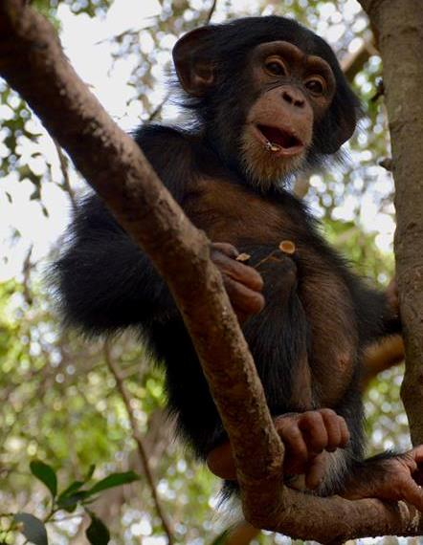
Right answer !!

Slide 26
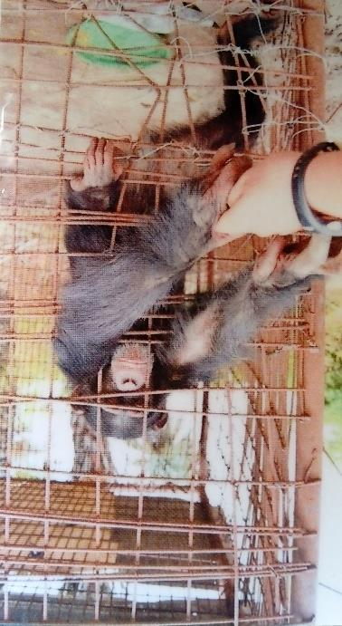
GOOD
OR
BAD

Slide 27
Wrong answer, start again !!

Slide 28
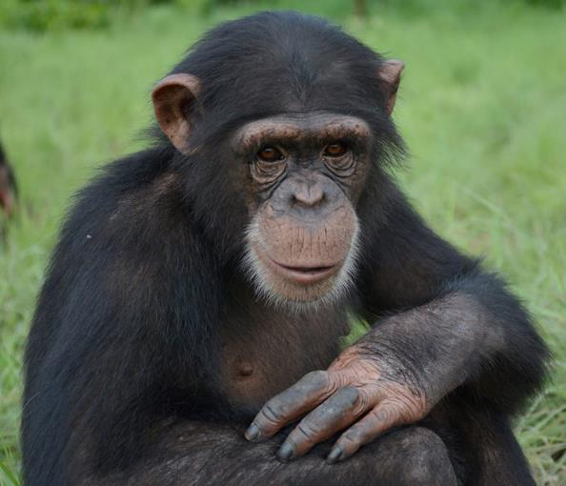
Right answer !!

Slide 29
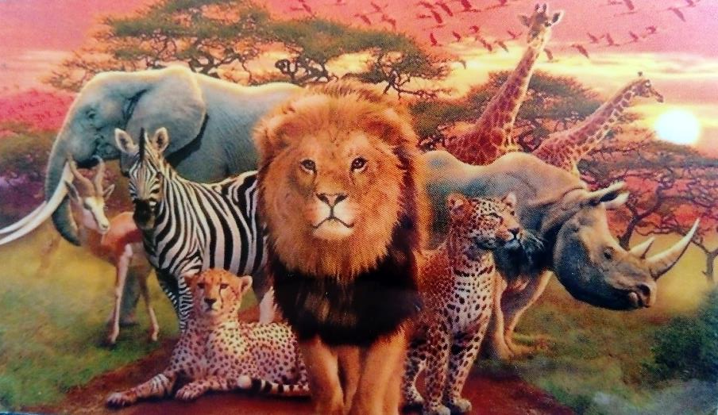
GOOD
OR
BAD

Slide 30
Wrong answer, start again !!

Slide 31
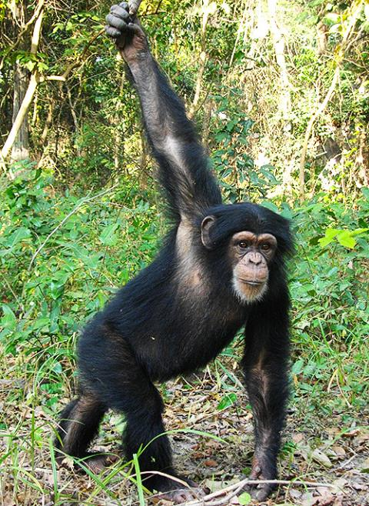
Right answer !!

Slide 32
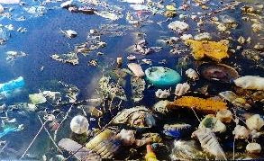
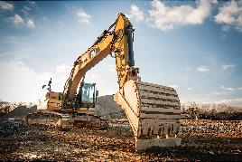
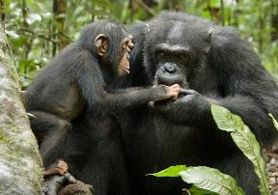
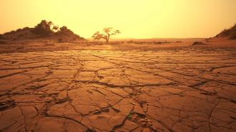
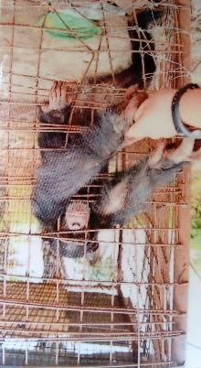
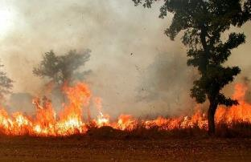
Overview
GOOD
BAD

